Slide 1
HOTEL MANAGEMENT SYSTEM
Welcome to SAAR International

Slide 2
DATABASE SYSTEMS (ITE1003) – PROJECT COMPONENT
SUBMITTED BY
Group Member 1: ROHIN GOYAL (19BIT0140)
Group Member 2: SUBHAM SUBHASISH PANDA (19BIT0093)
Group Member 3: AARUSH AGARWAL (19BIT0098)
Group Member 4: ADITYA (19BIT0139)
Submitted To
Dharmendra Singh Rajput
Associate Professor (Sr)

Slide 3
Introduction
Hotels are the major generators of tourist. Hotel Management involves a combination of various skills like management, marketing, human resource development, financial development, dexterity, etc.
Activities in the area of Hotel Management involves ensuring that all the operations like food and drinks, accommodation including the maintenance of finance and personal details of all the employee are well served.
The reservations, registrations, accounts, services, payment mode, extra activities are to be handled and maintained carefully and in an effective way to satisfy the guest as well as to check there is no leakage of profit to the hotel. The tool required for that is a strong database.

Slide 4
Improvements made in Review 2
01
02
03
04
05
Schema diagram has been created
All tables have been created
All tables have been populated
Basic queries have been performed.
ER Diagram has been updated

Slide 5
CREATING AND POPULATING TABLES
CREATE TABLE
Create table <Table Name>
( <Field1> <Data Type> <(width) <constraints> , <Field2> <Data Type> <(width)> <constraints>,
..................................);
POPULATE TABLE(INSERTING VALUES)
Insert into <tablename> values ( val1,val2 ...);

Slide 6
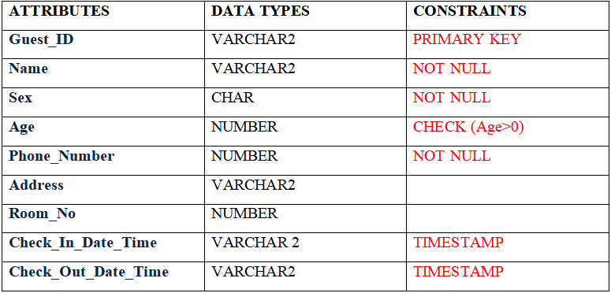
GUEST TABLE
SAMPLE INSERT
INSERT INTO Guest VALUES ('GUD001','Ratan Agarwal','M', 35 , 9857563389 ,'BHOPAL, MADHYA PRADESH', 102 , TIMESTAMP'2019-07-12 14:00:00', TIMESTAMP'2019-07-25 07:00:00');

Slide 7
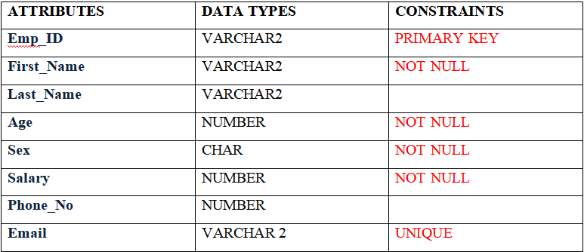
EMPLOYEE TABLE
SAMPLE INSERT
INSERT INTO Employee VALUES('EMP150','Susmita','Sen',34,'F',25000,8741864586,'saar150@saar.co.in');

Slide 8
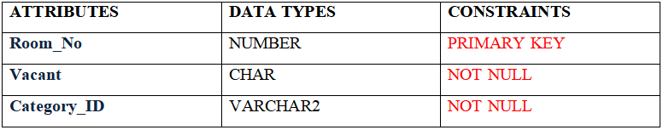
ROOM TABLE
SAMPLE INSERT
INSERT INTO Room VALUES (301,'Y','RCT004');

Slide 9
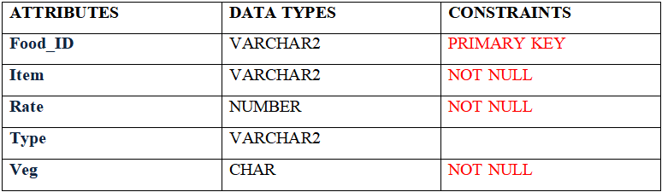
FOOD TABLE
SAMPLE INSERT
INSERT INTO Food VALUES('FOD0002','Poha',30,'Breakfast','Y');

Slide 10
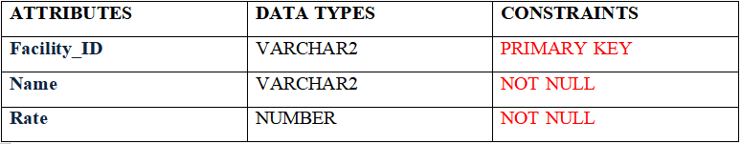
FACILITY TABLE
SAMPLE INSERT
INSERT INTO Facility VALUES('FAC0001','Swimming Pool',250);

Slide 11
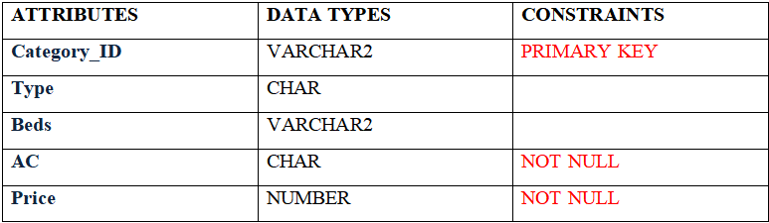
ROOM CATEGORY TABLE
SAMPLE INSERT
INSERT INTO Room_Category VALUES('RCT001','Deluxe',1,'Y',2000);

Slide 12
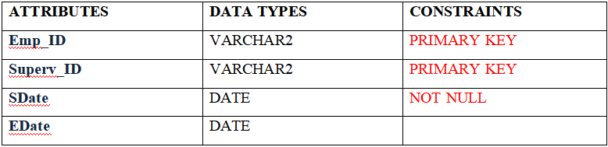
EMP_SUPERV TABLE
SAMPLE INSERT
INSERT INTO Emp_Superv VALUES ('EMP101','EMP122', TO_DATE('01-01-2019','dd-mm-yyyy'), null);

Slide 13
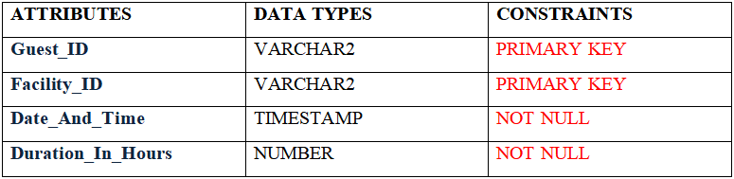
USES TABLE
SAMPLE INSERT
INSERT INTO Uses VALUES ('GUD001','FAC0001', TIMESTAMP'2019-07-12 15:00:00', 5.0 );

Slide 14
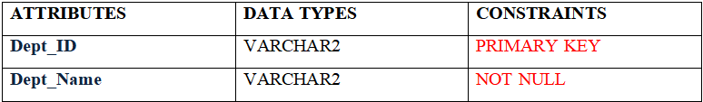
DEPARTMENT TABLE
SAMPLE INSERT
INSERT INTO Department VALUES('DEP006','Security');

Slide 15
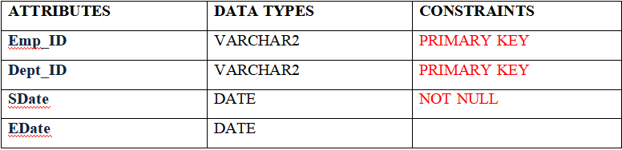
EMP WORKS TABLE
SAMPLE INSERT
INSERT INTO Emp_Work VALUES ('EMP101','DEP010', TO_DATE('01-01-2019','dd-mm-yyyy'), null);

Slide 16
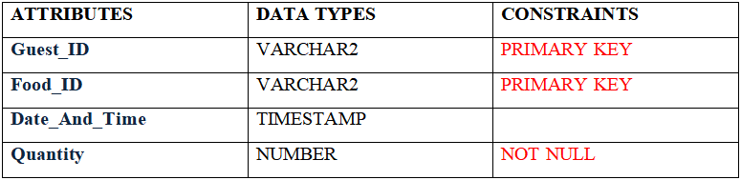
ORDERS TABLE
SAMPLE INSERT
INSERT INTO Orders VALUES ('GUD005','FOD0001',TIMESTAMP'2019-01-05 11:10:00', 2 );

Slide 17
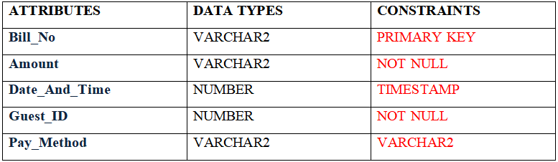
BILL TABLE
SAMPLE INSERT
INSERT INTO Bill VALUES ( 1 , 26185.0 , TIMESTAMP '2019-07-25 07:00:00','GUD001','Credit Card');

Slide 18
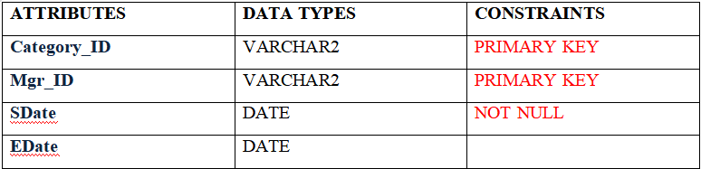
ROOM_CAT_MGR TABLE
SAMPLE INSERT
INSERT INTO Room_Cat_Mgr VALUES ('RCT001','EMP122', TO_DATE('01-01-2019','dd-mm-yyyy'), TO_DATE('12-05-2019','dd-mm-yyyy'));

Slide 19

DEPT_MANAGE TABLE
SAMPLE INSERT
INSERT INTO Dept_Manage VALUES ('EMP122','DEP001', TO_DATE('01-01-2019','dd-mm-yyyy'), null);

Slide 20
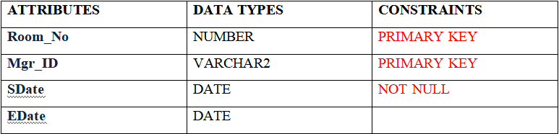
ROOM_MGR TABLE
SAMPLE INSERT
INSERT INTO Room_Mgr VALUES ( 101 ,'EMP138', TO_DATE('01-01-2019','dd-mm-yyyy'), TO_DATE('06-03-2019','dd-mm-yyyy'));

Slide 21

FACILITY MANAGE TABLE
SAMPLE INSERT
INSERT INTO Facility_Mgr VALUES ('FAC0001','EMP104', TO_DATE('01-01-2019','dd-mm-yyyy'), TO_DATE('19-07-2019','dd-mm-yyyy'));

Slide 22
QUERIES

Slide 23
1. Display all the vacant rooms
SELECT * FROM Room WHERE Vacant = ‘Y’;
2. Display the details of all Guests staying in the hotel now
SELECT *
FROM Guest
WHERE Check_Out_Date_Time IS NULL;

Slide 24
3. Display the details of all Guests residing between 1st August 2019 and 1st December 2019.
SELECT *
FROM Guest
WHERE Check_In_Date_Time > DATE'2019-08-01' AND
Check_In_Date_Time < DATE'2019-12-01';
4. Display the name and contact number of guests who have used the table tennis facility.
SELECT *
FROM Guest
WHERE Guest_ID IN
(SELECT Guest_ID
FROM Uses
WHERE Facility_ID IN
(SELECT Facility_ID
FROM Facility
WHERE Name = 'Table Tennis'));

Slide 25
5. Display the facilities used by guest id GUD003.
SELECT Name
FROM Facility
WHERE Facility_ID IN
(SELECT Facility_ID
FROM Uses
WHERE Guest_ID = 'GUD003');
6. Display the food ordered by guest id GUD001.
SELECT Item
FROM Food
WHERE Food_ID in
(SELECT Food_ID
FROM Orders
WHERE Guest_ID = 'GUD001');

Slide 26
7. Display details of all the senior citizens who have stayed in hotel.
SELECT name
FROM guest
WHERE age>60 ;
8. Display the details of the guest who having the maximum bill amount.
SELECT Name
FROM Guest
WHERE Guest_ID =
(SELECT Guest_ID
FROM Bill
WHERE amount =
(SELECT MAX(amount)
FROM Bill));

Slide 27
9. Display the details of female employees having salary greater than 50000.
SELECT * FROM Employee
WHERE Sex = 'F' AND SALARY> 50000
10. Display the details of all employees who are supervised by employee having id EMP123.
SELECT * FROM Emp_Superv
WHERE Superv_ID = 'EMP123'

Slide 28
11. Display average salary of employees working.
SELECT AVG(Salary) FROM Employee
12. Display the total combined salary of all employees.
SELECT SUM(Salary) FROM Employee

Slide 29
13. Display details of all guests from RAJASTHAN.
SELECT *
FROM Guest
WHERE address LIKE '%RAJASTHAN';
14. Display all items available for breakfast.
SELECT Item, Rate
FROM Food
WHERE Type = 'Breakfast';

Slide 30
15. Display details of room category having highest price.
SELECT Item, Rate
FROM Food
WHERE Type = 'Breakfast';
16. Display the details of all departments employee EMP110 has worked for
SELECT *
FROM Department
WHERE Dept_ID IN (
SELECT Dept_ID
FROM Emp_Work
WHERE Emp_ID = 'EMP110'
);

Slide 31
Thank you!

